Slide 1
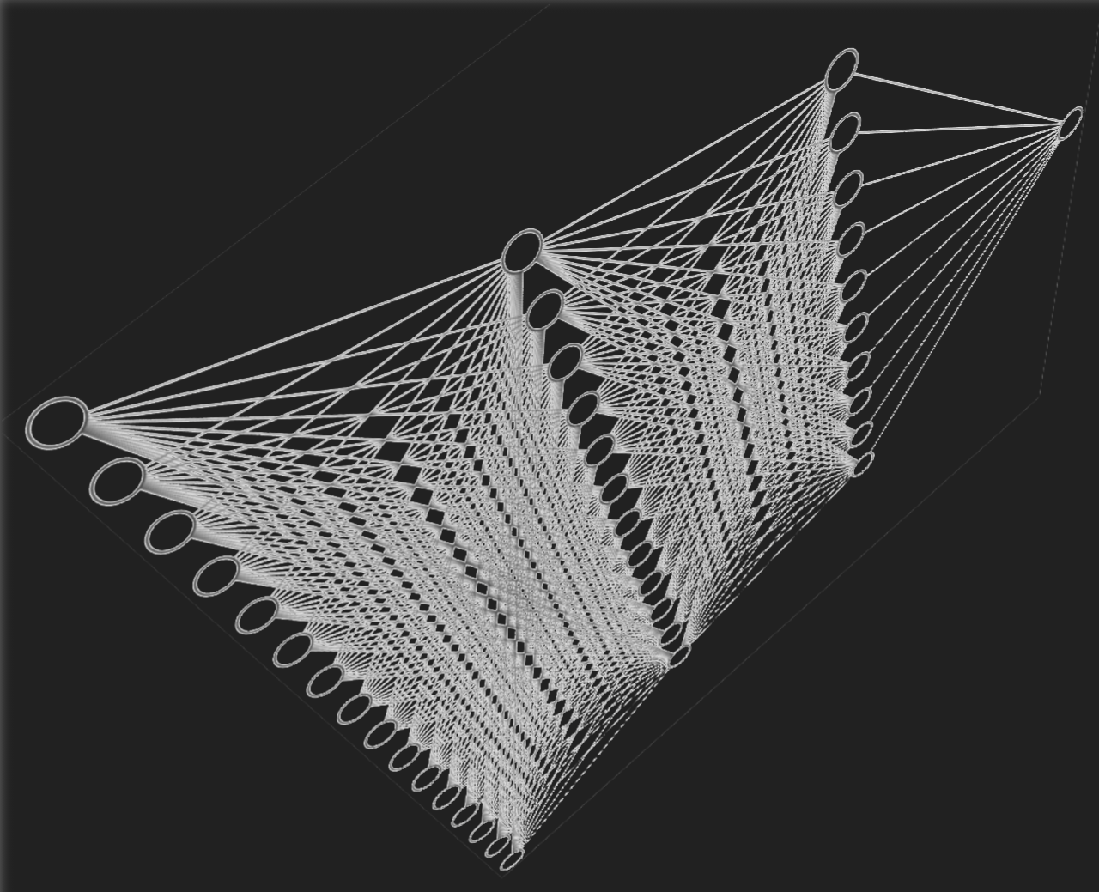
Parallelizing the Restricted Boltzmann Machine
By Kanishka Parankusham (ID : 101148153)
CSC 525 : High Performance Computing
Notes:
Good morning, my name is and my project is on parallelizing the restricted Boltzmann machine (RBM). RBMs are a popular machine learning model used for a variety of tasks, including dimensionality reduction, feature learning, and many body quantum mechanics. There is scope for parallelizing RBM training, particularly during Gibbs sampling and normalization.

Slide 2
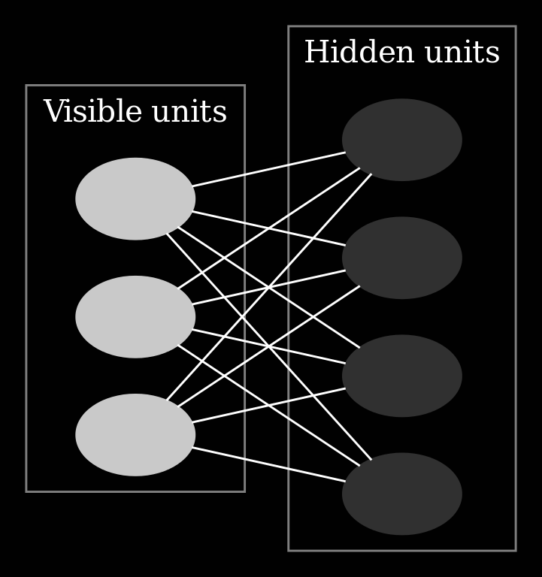
What is restricted boltzmann machine?
Restricted Boltzmann Machines (RBMs) are a type of artificial neural network that can be used for unsupervised learning. They are made up of two layers of neurons: a visible layer and a hidden layer. The visible layer represents the input data, while the hidden layer represents latent features of the input data.
RBMs work by learning to reconstruct the input data from the latent features. This is done through a process called Gibbs sampling. Gibbs sampling is a stochastic algorithm that iteratively samples from the probability distribution of the latent features.
RBMs can be used to generate new data, or to extract features from existing data. RBM features are often used as input to other machine learning models, such as classifiers and regressors.
The weights in an RBM are the connections between the visible and hidden layers. They represent the strength of the relationship between each visible unit and each hidden unit.
The weights of an RBM are important because they determine the ability of the RBM to learn and represent the underlying structure of the data. By carefully adjusting the weights, it is possible to train RBMs to learn complex relationships in the data.
Notes:
They Enhance features or highlight important factors

Slide 3
What is the purpose of the project?
Enhancing RBM Performance Through Parallelization: A Comprehensive Exploration
This project delves into the realm of parallelization techniques, aiming to optimize the processing time of Restricted Boltzmann Machines (RBMs) and comprehensively explore the functionalities of parallelization libraries and tools within the context of modern computing.

Slide 4
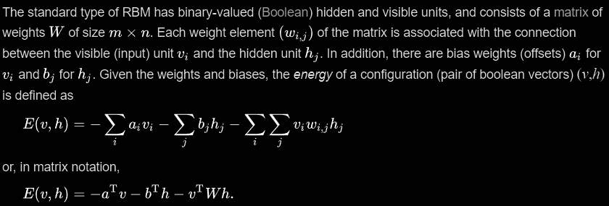
RBM Algorithm
Notes:
Here we can see the RBM algorithm it consists of matrix of W weights. Each weight is associated with connection between hidden and visible layers.
a and b are biases,
visible and hidden layer nodes(their respective weights),
W is weight between hidden and visible node
{
Imagine you are trying to roll a ball down a hill. The ball will roll down the hill until it reaches the bottom, where the energy is lowest.
The energy function of an RBM is like the hill. The visible and hidden layer activations are like the ball. The RBM is trying to roll the ball down the hill until it reaches the bottom, where the energy is lowest.
The lower the energy, the more likely the visible and hidden layer activations are to be compatible. This is because the RBM is trying to learn the probability distribution of the input data.
In order to learn the probability distribution of the input data, the RBM needs to minimize the energy function. This is why the RBM's energy function is negative.
Here is a more concrete example:
Imagine you are trying to learn the probability distribution of the following binary data:
[0, 1, 0, 1]
You can start by randomly initializing the visible and hidden layer activations. The energy function will be high because the visible and hidden layer activations are not compatible.
You can then use the contrastive divergence algorithm to update the weights of the RBM. The contrastive divergence algorithm will update the weights in a way that minimizes the energy function.
After a certain number of iterations, the contrastive divergence algorithm will converge. The RBM will have learned the probability distribution of the input data, and the energy function will be low.
}

Slide 5


Training the algorithm
Restricted Boltzmann machines are trained to maximize the product of probabilities assigned to some training set V (a matrix, each row of which is treated as a visible vector v),
The algorithm most often used to train RBMs, that is, to optimize the weight matrix W, is the contrastive divergence (CD) algorithm due to Hinton, originally developed to train PoE (product of experts) models. The algorithm performs Gibbs sampling and is used inside a gradient descent procedure (similar to the way backpropagation is used inside such a procedure when training feedforward neural nets) to compute weight update.
The basic, single-step contrastive divergence (CD-1) procedure for a single sample can be summarized as follows:
Take a training sample v, compute the probabilities of the hidden units and sample a hidden activation vector h from this probability distribution.
Compute the outer product of v and h and call this the positive gradient.
From h, sample a reconstruction v' of the visible units, then resample the hidden activations h' from this. (Gibbs sampling step)
Compute the outer product of v' and h' and call this the negative gradient.
Let the update to the weight matrix W be the positive gradient minus the negative gradient, so the times some learning rate is:
Update the biases a and b analogously:
Notes:
And this is the training algorithm used for our model. For RBM we mostly use Contrastive divergence algorithm which was originally used to train Product of Experts models (which highlights underlying structures). In simple terms we would be training Gibbs samples which is a Markov chain Monte Carlo algorithm.(for obtaining a sequence of observations which are approximated from a specified multivariate probability distribution, when direct sampling is difficult)

Slide 6
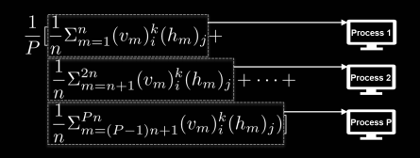
Our Approach
Test
Stage 1
Stage 2
Stage 3
Stage 4
Stage 5
Stage 6
Stage 7
Gather training data
Choosing suitable platform and environment
Create a model
Test the model
Apply parallelization techniques
Evaluating the model
Review
Optimize
Training
Adding Values
Initialise training data modify code for parallelization
Scaling various values and weights
Parallelization of Gibbs samples
Tensorflow Training
Notes:
This approach to project was not this perfect as the model, initializing the environment will need execution was pretty difficult. Applying parallelization techniques and including libraries was daunting task for me. Every time we have to change the environment to suitable libraries.

Slide 7





Tools used for the software
Notes:
The project was done in python jupyter notebook. Anaconda was used to set an environment which greatly helped in the project. Tensorflow was used to train the gibbs samples. As for parallelization we used Nvidia cuda toolkit and and tensorflow library(past tensorflow gpu)

Slide 8
Device specification and Libraries used
CPU: AMD Ryzen 5 4600H (6 core)
GPU: Nvidia GeForce GTX 1650 Ti (Cuda cores: 1024, 4GB GDDR5)
Libraries used:
Python: 3.9.18
Tensorflow: 2.10.1
Numpy: 1.25.0
Panda: 2.1.1
Matplot: 3.8
Os.environ
Threading
Cuda version: 12.3
Notes:
I have used my laptop to compute the results. Few of the python libraries i used in this project. I had to revert few version each time i started using a library. Working of GPU in tensorflow was a bit tricky.

Slide 9
Dataset used
Movielens:
These files contain 1,000,209 anonymous ratings of approximately 3,900 movies
made by 6,040 MovieLens users who joined MovieLens in 2000.

Slide 10
Methodology
Importing libraries
Load test data and modify them for computation
Testing parallel and serial execution while programming itself
Merge user ratings and movies then initialize the test group( create training list)
Initializing hidden units(can be anything because it changes once the program runs)
Normalizing the scores using sigmoid and relu(tensorflow function). Updating positive and negative gradients(These are biases).
And updating out matrix
Initialize the biases and weights.
Start training with batch size and number of epochs.(Check with CPU and GPU)
After training select a user you want find recommendations for.
Feed the users data.
Print out a list of n movies for display with score sorted. Merge and Display.
Notes:
This should have been a flowchart

Slide 11
Parallelization of the program
There were not many areas we can use or demonstrate parallelization in the program.
There were only few areas where we can modify the code and parallelize the code.
The system was successfully run the code in a cuda based GPU which itself is a form of parallelization. The mutex and training functions where used and performed well with the GPU.
Lets see the overheads statistics in later slides…

Slide 12
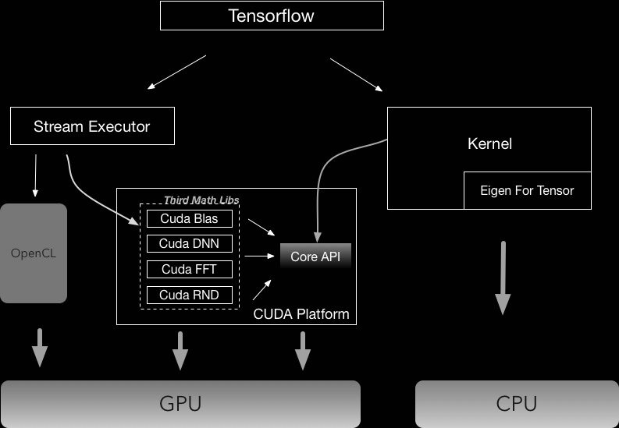
How does a Cuda GPU work?
The GPU supported parallel programs that were more parallel than those of the CPU. But unlike multithreaded CPUs, which supported computing different functions at the same time, the GPU focused on computing the same function simultaneously on multiple elements of data.
Almost all the framework for machine learning uses parallelized implementation of all the possible operations. This is achieved by CUDA programming, NVIDIA API to do parallel computations on NVIDIA GPUs. You don't write it explicitly, it's all done at low level, and you do not even get to know.

Slide 13
Test evaluation
Test case with 1000 users, learning rate set to 1.0, batch size = 100. (Results are in seconds)
Time taken by program with CPU: 28 seconds
Time taken by program with GPU:25 seconds
Speedup: 1.12
Speedup when using parallelized the code: 0.08

Slide 14
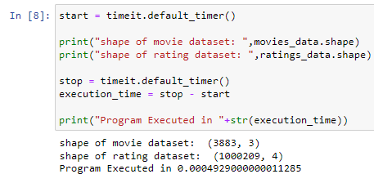
Why the speed up for parallel code slower?
Let's look at the snippet of code for both the both processes for printing the shape of the matrix. First let's look at without parallelization.

Slide 15
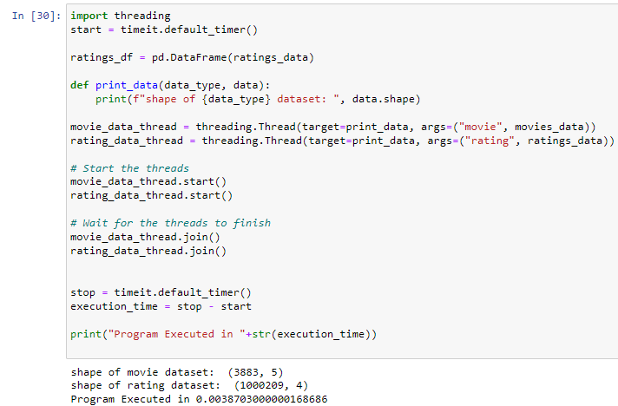
Next let's look at parallelized one
As we can see it's much longer longer and overcomplicating things. Parallelization can be only used in few cases where there is scope for it. And each time you create you have to join them in code.

Slide 16
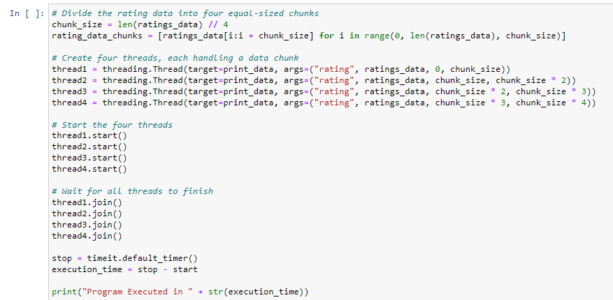
Crude example for using 4 threads. To enhance this we can use for loops for starting and ending threads.

Slide 17
Challenges faced
Setting up GPU for tensorflow and making it work with the environment took quite some time. Next time making use of google colab or a linux system would be much better option.
Inherent python weakness:
Multi-Threading and the Global Interpreter Lock (GIL) .The Global Interpreter Lock (GIL) also affects multithreading in Python. The GIL works by putting a lock on each variable and maintaining a usage counter. This even takes effect on multiprocess library.
Limited Threading Support: Python's built-in threading module provides a basic framework for parallel execution, but it may not be sufficient for complex parallelization scenarios. Advanced libraries like multiprocessing or task schedulers like Celery are often required.
Overhead of Parallelization: Parallelization introduces overhead in terms of thread creation, synchronization, and communication between threads or processes. This overhead can sometimes outweigh the performance gains, especially for small or I/O-bound tasks.
Not much support for its libraries. For example I tried using joblib, Pandaral·lel, pycuda, etc. Importing them was also a daunting task.Most of libraries in python don’t support even a years back python version.
Downgrading means changing variables of different systems which would take more time intinalize and make them run.

Slide 18
Work for future
Parallelisation is big topic there can be further improvements such as:
The code can be much more optimized if it was parallelized from the scratch with good knowledge of parallel python libraries and their working.
Tensorflow code(GPU) can be much more optimized my making use of its functions.
Further improvement can be made with use of MPI. There are many libraries that support python with distributed frameworks. (If access granted from college we can reality test this scenario).(Tensorflow allows distributed functions such as tf.distribute.Strategy which is used to initialize the gpus and allocate data).
Making use of google colab would have been much faster in terms of the project. Google even provides virtual GPU’s and TPU’s. (Basically we can run programs on their server)

Slide 19
Conclusion
From this project, we observed use of parallel computing in a Deep Belief model(RBM). Overall the whole code can be way more optimized but using parallel techniques can have many overheads to consider. Even invoking a single thread activates the whole core or cores which can lead to additional execution time.
Usage of GPU’s for computing these models has been only way to execute such algorithms which require massive computational power. With addition to distributed computing High performance computing can be increased by many fold.

Slide 20
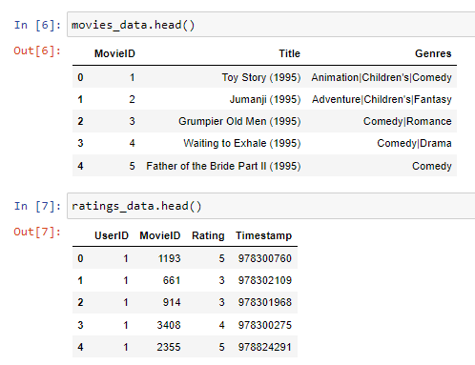
Few project outputs:

Slide 21
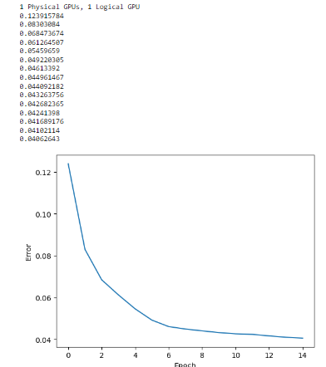
Few project outputs:

Slide 22
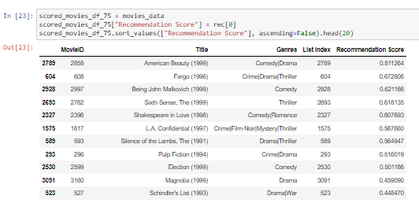
Few project outputs:

Slide 23
Reference Articles
Yang, Pei, et al. "Parallelized training of restricted boltzmann machines using markov-chain monte carlo methods." SN Computer Science 1.3 (2020): 165.
Zhu, Yun, Yanqing Zhang, and Yi Pan. "Large-scale restricted Boltzmann machines on single GPU." 2013 IEEE International Conference on Big Data. IEEE, 2013.
Hinton, Geoffrey E. "A practical guide to training restricted Boltzmann machines." Neural Networks: Tricks of the Trade: Second Edition. Berlin, Heidelberg: Springer Berlin Heidelberg, 2012. 599-619.
Horovod. “Horovod/Horovod: Distributed Training Framework for Tensorflow, Keras, Pytorch, and Apache MXNet.” GitHub, github.com/horovod/horovod.
Echen. “GitHub - Echen/Restricted-boltzmann-machines: Restricted Boltzmann Machines in Python.” GitHub, github.com/echen/restricted-boltzmann-machines.
Kurama, Vihar. “Beginner'S Guide to Boltzmann Machines in PyTorch | Paperspace Blog.” Paperspace Blog, 9 Apr. 2021, blog.paperspace.com/beginners-guide-to-boltzmann-machines-pytorch.
“Parallelizing Python Code | Anyscale.” Anyscale,www.anyscale.com/blog/parallelizing-python-code.
Cueto, María Angélica, Jason Morton, and Bernd Sturmfels. "Geometry of the restricted Boltzmann machine." Algebraic Methods in Statistics and Probability 516 (2010): 135-153.
Serrano.Academy. “Restricted Boltzmann Machines (RBM) - a Friendly Introduction.” YouTube, 7 July 2020, www.youtube.com/watch?v=Fkw0_aAtwIw.
https://www.tensorflow.org/api_docs/python/tf/all_symbols
https://docs.nvidia.com/cuda/

Slide 24
Thank you

Slide 25
Slide speaker notes
Slide 1: RBMs are a popular machine learning model used for a variety of tasks, including dimensionality reduction, feature learning, and many body quantum mechanics. There is scope for parallelizing RBM training, particularly during Gibbs sampling and normalization.
Slide 2: They Enhance features or highlight important factors
Slide 4: Here we can see the RBM algorithm it consists of matrix of W weights. Each weight is associated with connection between hidden and visible layers. a and b are biases, visible and hidden layer nodes(their respective weights), W is weight between hidden and visible node Imagine you are trying to roll a ball down a hill. The ball will roll down the hill until it reaches the bottom, where the energy is lowest. The energy function of an RBM is like the hill. The visible and hidden layer activations are like the ball. The RBM is trying to roll the ball down the hill until it reaches the bottom, where the energy is lowest. The lower the energy, the more likely the visible and hidden layer activations are to be compatible. This is because the RBM is trying to learn the probability distribution of the input data. In order to learn the probability distribution of the input data, the RBM needs to minimize the energy function. This is why the RBM's energy function is negative. Here is a more concrete example: Imagine you are trying to learn the probability distribution of the following binary data: [0, 1, 0, 1] You can start by randomly initializing the visible and hidden layer activations. The energy function will be high because the visible and hidden layer activations are not compatible. You can then use the contrastive divergence algorithm to update the weights of the RBM. The contrastive divergence algorithm will update the weights in a way that minimizes the energy function. After a certain number of iterations, the contrastive divergence algorithm will converge. The RBM will have learned the probability distribution of the input data, and the energy function will be low. }

Slide 26
Slide speaker notes
Slide 5: And this is the training algorithm used for our model. For RBM we mostly use Contrastive divergence algorithm which was originally used to train Product of Experts models (which highlights underlying structures). In simple terms we would be training Gibbs samples which is a Markov chain Monte Carlo algorithm.(for obtaining a sequence of observations which are approximated from a specified multivariate probability distribution, when direct sampling is difficult)
Slide 6: This approach to project was not this perfect as the model, initializing the environment will need execution was pretty difficult. Applying parallelization techniques and including libraries was daunting task for me. Every time we have to change the environment to suitable libraries.
Slide 7: The project was done in python jupyter notebook. Anaconda was used to set an environment which greatly helped in the project. Tensorflow was used to train the gibbs samples. As for parallelization we used Nvidia cuda toolkit and and tensorflow library(past tensorflow gpu)
Slide 8: I have used my laptop to compute the results. Few of the python libraries i used in this project. I had to revert few version each time i started using a library. Working of GPU in tensorflow was a bit tricky.
Slide 10: This should have been a flowchart

